Slide 1
HL7 RIM + Introduction to FHIR
November 18, 2021
Lloyd McKenzie

Slide 2

Who am I?
Name: Lloyd McKenzie
Company: Gevity
Background:
One of FHIR’s 3 initial editors
Co-chair FHIR Management Group and FHIR-Infrastructure
HL7 Fellow
Heavily involved in HL7 and healthcare exchange for last 19 years (v2, v3, CDA, etc.)
lmckenzie@gevityinc.com

Slide 3
Acknowledgements
Grahame Grieve
Lloyd McKenzie
Ewout Kramer
David Hay
Josh Mandel
Brett Marquard
Rik Smithies
et al

Slide 4
HL7 RIM

Slide 5
V3 – a standard in decline
V3 has only really succeeded in a few environments
Canada, UK, Netherlands, FDA
All places with large investments (i.e. billions of $$)
CDA is the one exception
V3 is now in significant decline
Very little energy at HL7 international
Was never picked up by large EHR vendors
Tooling infrastructure is fragile and not well maintained
Canada has developed and maintained some additional tooling infrastructure
Even countries where v3 was widely adopted are now looking at FHIR
Now starting to happen in Canada

Slide 7
Core concepts of RIM
Every happening is an Act
Procedures, observations, medications, supply, registration, etc.
Acts are related through an ActRelationship
composition, preconditions, revisions, support, etc.
Participation defines the context for an Act
author, performer, subject, location, etc.
The participants are Roles
patient, provider, practitioner, specimen, specimen, etc.
Roles are played by Entities
persons, organizations, material, places, devices, etc.
Notes:
Duplicate specimen

Slide 8
RIM Core Attribute Value Sets
Living Subject
Person
Organization
Material
Place
...
Observation
Procedure
Supply
Substance Adm
Invoice
...
Performer
Author
Witness
Subject
Destination
...
Entity
Class Code
Act
ClassCode
Participation
Type Code
Entity
Role
Participation
Act
classCode : CS
code : CE
determinerCode : CS
statusCode : CS
0..1
player
classCode : CS
code : CE
effectiveTime : IVL<TS>
typeCode : CS
time : IVL<TS>
statusCode : CS
classCode : CS
code : CD
moodCode : CS
statusCode : CS
effectiveTime : GTS
0..*
1
1
0..*
0..*
0..1
scoper
0..*
Patient
Employee
Assigned Entity
Licensed Entity
Guarantor
...
Kind
Instance
(Qualified Group)
Definition
Promise
Order
Event
Criterion
...
Entity
Determiner
Code
Role
Class Code
Act
Mood Code

Slide 9
Acts Have Moods
Proposal
PRP
Order
ORD
Promise
PRM
Event
EVN
Why don’t you clean your room today honey?
Clean your room!
All right, I’ll clean it!
Room is cleaned.

Slide 10
Associations between Roles and Entities
Uptown
Hospital
Downtown
Hospital
Scoped
By
Scoped
By
Joe Smith
Doctor
Patient
Plays
Plays

Slide 11
FHIR

Slide 12
Complexity Model
Snomed
HL7 V3
openEHR
WS
CDA
Difficulty (log)
XML
How?
HL7 v2
HTTP / HTML
???
Text
Semantic Depth
Notes:
Stole this slide from Lloyd. Because I like it.
Semantic Depth - Knowledge captured in the model.
V2 old, and limited by it’s own rules (though hugely successful)
- V2 version 2 messaging. Pipes and Hats (EDIfact) format – 25 yrs old. Very implementation specific so no two implementations are the same which leads to the need for integration engines to coax interoperability. Doesn’t scale well across organization boundaries
V3 too slow and too hard
- 3-7+ years for a domain to become normative. V3 messaging not widely implemented. Robust modeling but complex and opaque and thus hard to implement. ( for example the content is cluttered with semantic structures )
CDA has success, but both limited and too hard
+ Different contexts of interoperability → different representations that aren’t compatible
Nothing suitable for light-weight integration or for Health 2.0 (WIKIpedia: “While the "2.0" moniker was originally associated with concepts like social networking, collaboration, openness, and participation,^{[5]} in recent years the use of Health 2.0 has migrated to mean the role of SaaS & Cloud-based technologies and their associated applications on multiple devices. Health 2.0 describes the integration of these into much of general clinical and administrative workflow in health care.”
Question is how to get both semantic depth and ease of implementation?

Slide 13
The Goals of FHIR
Implementer Focus
Target the 80% (common stuff)
Use today’s web technologies
Support human readability
Paradigm & architecturally agnostic
Open Source

Slide 14
Implementer Focus
Specification is written for one target audience… Implementers
Rationale, modeling approaches, etc. kept elsewhere
Make the resources simple and easy to understand and use
Multiple Implementation tools to help get you started from day 1
Publicly available test servers
Starter APIs published with spec
C#, Java, Pascal, ObjectiveC, Javascript
Lots and lots of examples (and they’re valid too)
Notes:
Specification is written for one target audience: implementers - vs modelers (V3) or clinicians
Rationale, modeling approaches, etc. kept elsewhere - mappings exist more on this later
Resources are simple and easy to understand and use - more on this later
Multiple Implementation tools to help get you started from day 1
Publicly available test servers
Starter APIs published with spec
C#, Java, Pascal, ObjectiveC, Javascript
Lots of examples (and they’re valid too)
Connectathons to verify specification approaches
‘Safe’ extensibility baked in
Who’s read the v3 spec? – modeler & balloter focused
Spec is driven by people who write code for a living
‘Resource’ is the basic building block of FHIR (more on that later)
Numerous pieces have been changed because of experience with what worked when trying to implement
Even have a test workbench for RESTful servers – URL?
External libraries already available
Whole spec is built like software project

Slide 15
Support the 80%
Focus on scenarios that the implementers ask for
Decision to include content into the core specification:
“We only include data elements if we are confident that most normal implementations using that resource will make use of the element” (80% rule)
Other content is included through creation of Profiles and extensions
Notes:
Design by constraint failed – years to develop, what was produced required yet more design to be implementable and after that might not be interoperable
How to determine the 80%? Look to existing specs – v2, v3, CDA templates, OpenEHR, jurisdictional projects, what implementations we’ve seen
If not sure, err on the side of “not in for now”
Note: not 80% of instances, 80% of implementations
Challenges with “raising the bar”
What happens when there aren’t many/any implementations?

Slide 16
Example: HL7 v3 Address
isNotOrdered, updateMode, flavorId, nullFlavor, controlAct root & extension, validTime low and high, useable period (low, high) (GTS – no room on the slide), use
home, primary home, vacation home, workplace, direct, public, bad, physical, postal, temporary, alphabetic, ideographic, syllabic, search, soundex, phonetic, old
0..* parts, each with:text
value, code, code system, code system name, code system version, language, type:
address line, additional locator, unit identifier, unit designator, delivery address line, delivery installation type, delivery installation area, delivery installation qualifier, delivery mode, delivery mode identifier, street address line, building number, building number numeric, building number suffix, street name, street name base, street type, direction, intersection, care of, census tract, country, county or parish, municipalitycity, delimiter, post box, precinct, state or province, postal codezip, delivery point identifier
Notes:
This is what happens when you apply the 80% . . .

Slide 17
Example: FHIR Address
isNotOrdered, updateMode, flavorId, nullFlavor, controlAct root & extension, validTime low and high, useable period (low, high) (GTS – no room on the slide), use
home, primary home, vacation home, workplace, direct, public, bad, physical, postal, temporary, alphabetic, ideographic, syllabic, search, soundex, phonetic, old
0..* parts, each with:text
value, code, code system, code system name, code system version, language, type:
address line, additional locator, unit identifier, unit designator, delivery address line, delivery installation type, delivery installation area, delivery installation qualifier, delivery mode, delivery mode identifier, street address line, building number, building number numeric, building number suffix, street name, street name base, street type, direction, intersection, care of, census tract, country, county or parish, municipalitycity, delimiter, post box, precinct, state or province, postal codezip, delivery point identifier
Notes:
This is what happens when you apply the 80% . . .

Slide 18
Web Technologies
Same technologies that drive Google, Facebook & Twitter
HTTP
DataTypes W3C compliant
XML, JSON, RDF
REST API
HTTPS, OAuth, etc. for security functions
Notes:
We try very hard to *not* invent stuff that exists elsewhere unless it’s really broken or totally unaligned with the FHIR principles.
Atom was used for collection of resources into a bundles - Replaced in DSTU-2 with FHIR bundle
RESTful implementation based upon REST.

Slide 19

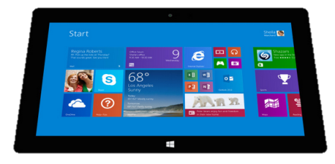
Paradigm Agnostic
The content is the same whatever the interoperability paradigm
Receive a lab result in a message…
National
Exchange
FHIR Message
FHIR
Repository
FHIR Document
Lab System
REST
…Package it in a discharge summary document
…Update a patient record
19

Slide 20
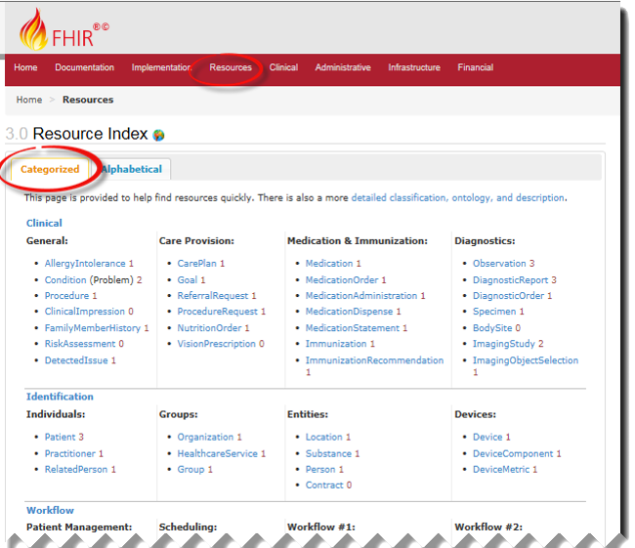
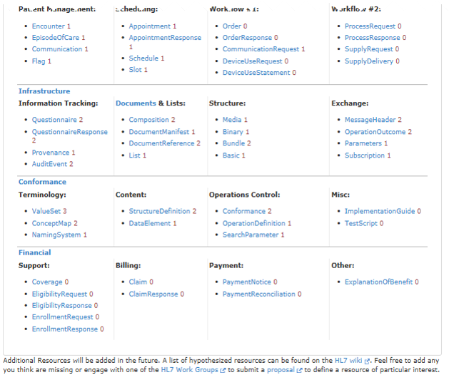
FHIR Resources
Notes:
Examples
Administrative
Patient, Practitioner, Organization, Location, Coverage, Invoice
Clinical Concepts
Allergy, Condition, Family History, Care Plan
Infrastructure
Document, Message, Profile, Conformance
NOT Resources
Gender - datatype
Too small
Electronic Health Record -
Too big
Blood Pressure - Profile
Too specific
Intervention
Too broad
The top 50 (commonly Posted ) resources instances on a sampling of publicly available FHIR Servers. Out of 94
100-150 total - ever

Slide 21
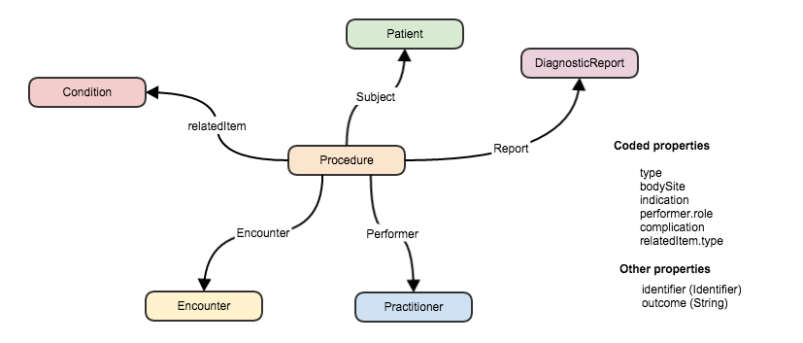
Connecting Resources
FHIR resource
“container” of information that represent something in the real world
Link between resources
Notes:
Can create a ‘network’ of interrelated resources through referencing rather than sending all the data. By resources referencing each other extensively they form a web of information.

Slide 22
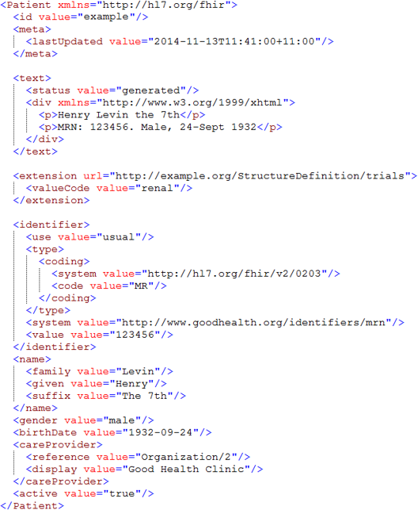
Identity & Metadata
Human Readable Summary
Extension with reference to its definition
Standard Data Content:
MRN
Name
Gender
Date of Birth
Provider

Slide 23
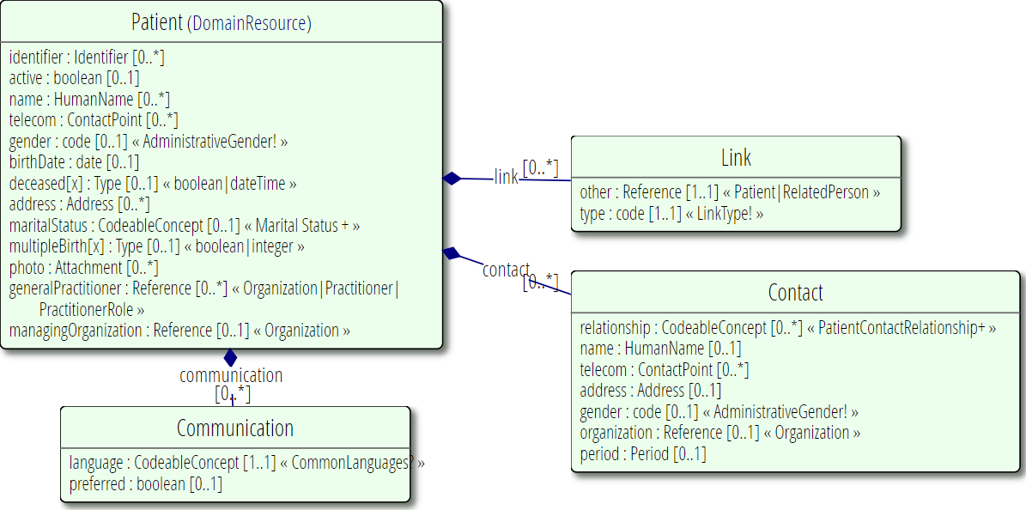
Resource Definitions

Slide 24
REST: a URL based API
https://server.org/fhir/Patient/1
resource type
endpoint
id
Note: This URL resolves to the current version of a resource
It’s also specific to a server
Notes:
This is not only the URL you use to retrieve the resource, it’s also its id.
All URL’s in FHIR are case-sensitive (and so is the id)

Slide 25
REST: Search
https://server.org/fhir/Patient?name=Smith
resource type
endpoint
search term
Note – no ID specified
Notes:
This is not only the URL you use to retrieve the resource, it’s also its id.
All URL’s in FHIR are case-sensitive (and so is the id)

Slide 26
FHIR REST URLs
Template | Description | Example | Operations
[base] | Server URL | http://fhir.com | GET, POST
[base]/[type] | Collection Manager | http://fhir.com/Patient | GET, POST
[base]/[type]/[id] | URL for a resource | http://fhir.com/Patient/23 | GET, PUT, DELETE, PATCH
[base]/[type]/[id]/_history/[vid] | Past version | http://fhir.com/Patient/23/_history/2 | GET
[base]/([type]/([id]/)?)?$[name] | Operation (server action) | http://fhir.com/Patient/23/$everything | GET, POST

Slide 27
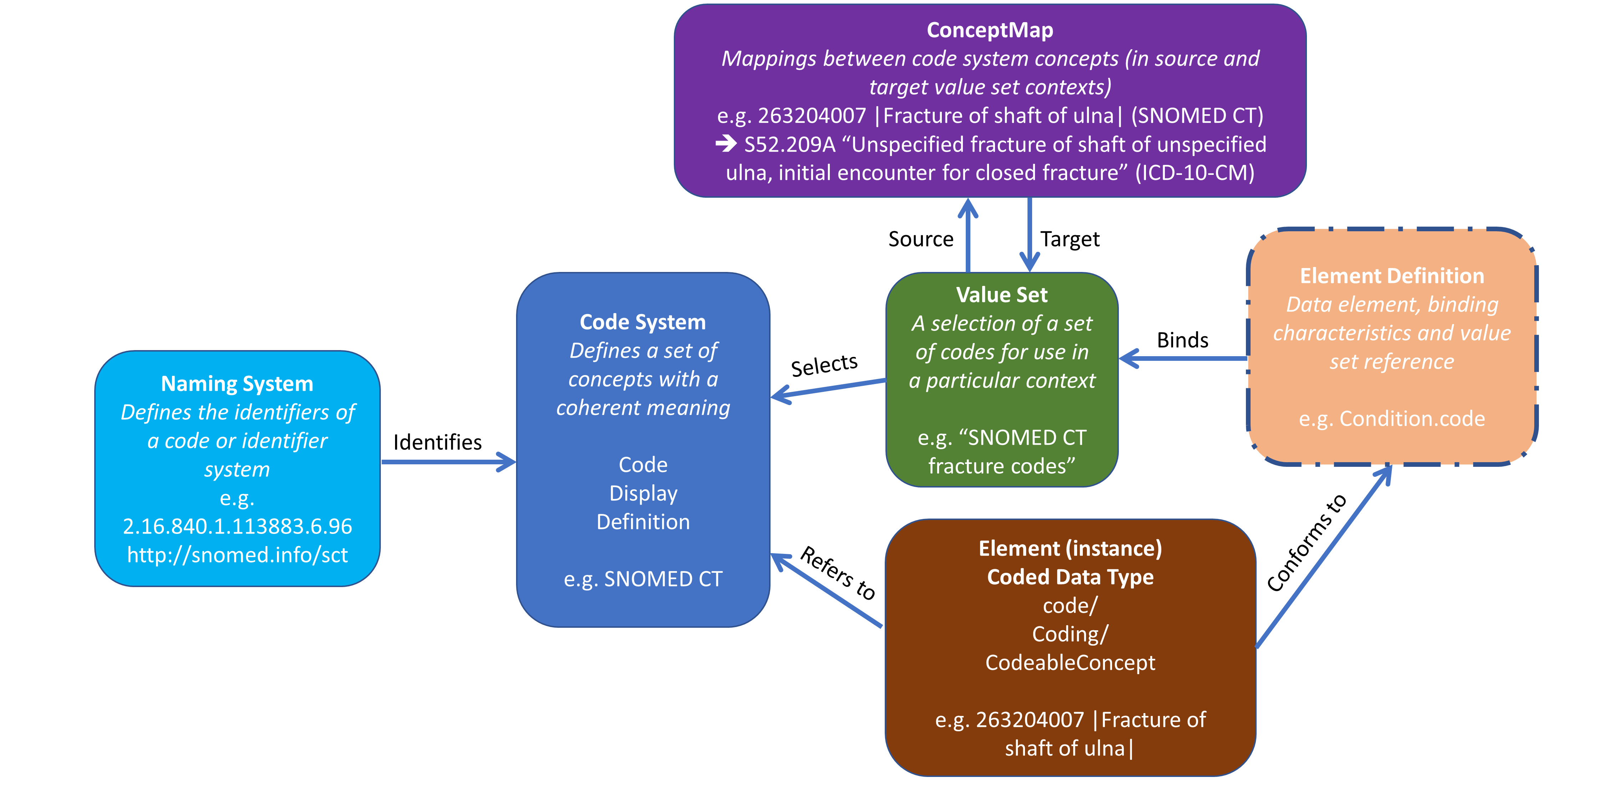
FHIR & Terminology

Slide 28
FHIR Profiles
Many different contexts in healthcare, but a single set of Resources
Need to be able to describe restrictions based on use and context
Allow for these usage statements to be:
Authored in a structured manner
Published in a repository
Used as the basis for validation, code, report and UI generation.
Profiling is going to be very important!

Slide 29
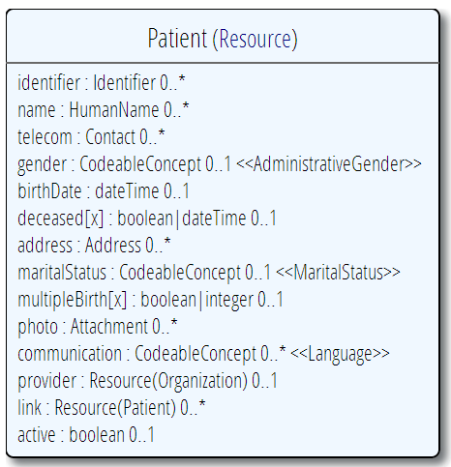
Profiling a resource. For example...
List of contraints in the profile
Require that the identifier uses the NHI – and is required
Limit names to just 1 (instead of 0..*)
Limit maritalStatus to another set of codes that extends the one from HL7 international
Add an extension to support “iwi” (NZ example)
Constrain out animal element (card. => 0..0)
Notes:
Note: hardly any mandatory elements in the core spec!
Tools for creating profile being develop - Forge..

Slide 30
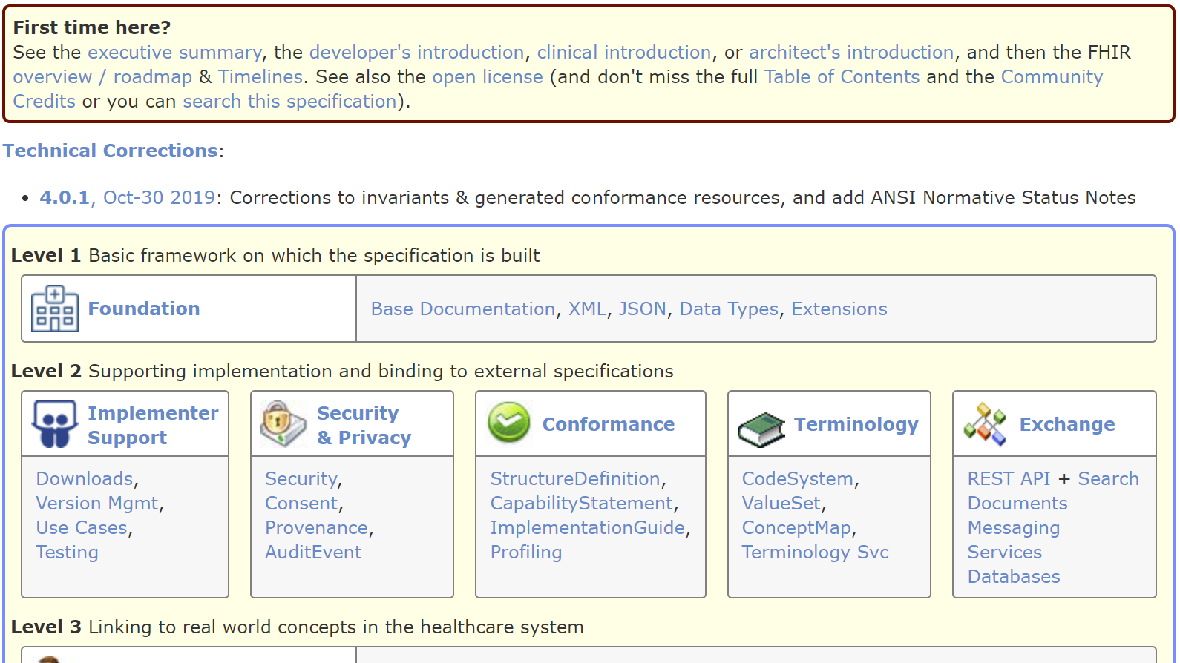
The FHIR spec

Slide 31
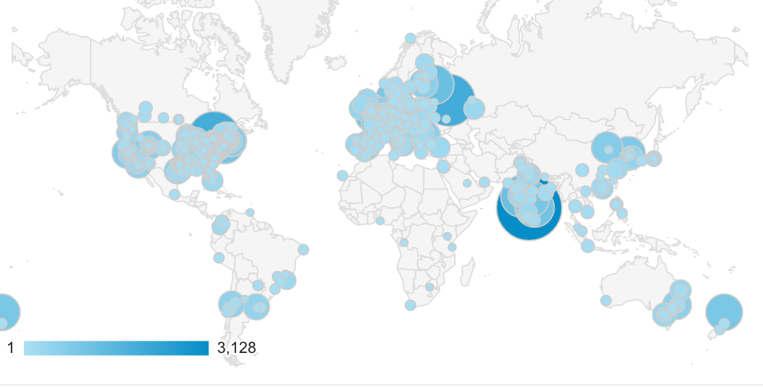
Who’s using FHIR?
Systems accessing HAPI server in previous year (as of 2017-05)
Notes:
Jan->mid Nov. 2015 – unique systems accessing the HAPI test server

Slide 32


Implementation Assistance
http://chat.fhir.org (“Zulip”)
http://stackoverflow.com/questions/tagged/hl7-fhir
32
Notes:
Zulip - >500 participants – many streams
Stack Overflow – ask implementation questions
Link from front page
Search for answers first
Don’t ask for changes to the spec (get deleted!)
gForge Tracker – ask for changes to the spec
Link from bottom of every page
But have discussion somewhere first
FHIR Email list, Connectathons, Tutorials
See Wiki for details

Slide 33
Thank You –
Questions?
lmckenzie@gevityinc.com

